Slide 1
Map Routing Project
Brief Description

Slide 2
Agenda
Problem Definition (full description doc)
Input
Output
Example
Test Cases (description doc)
Deliverables

Slide 3
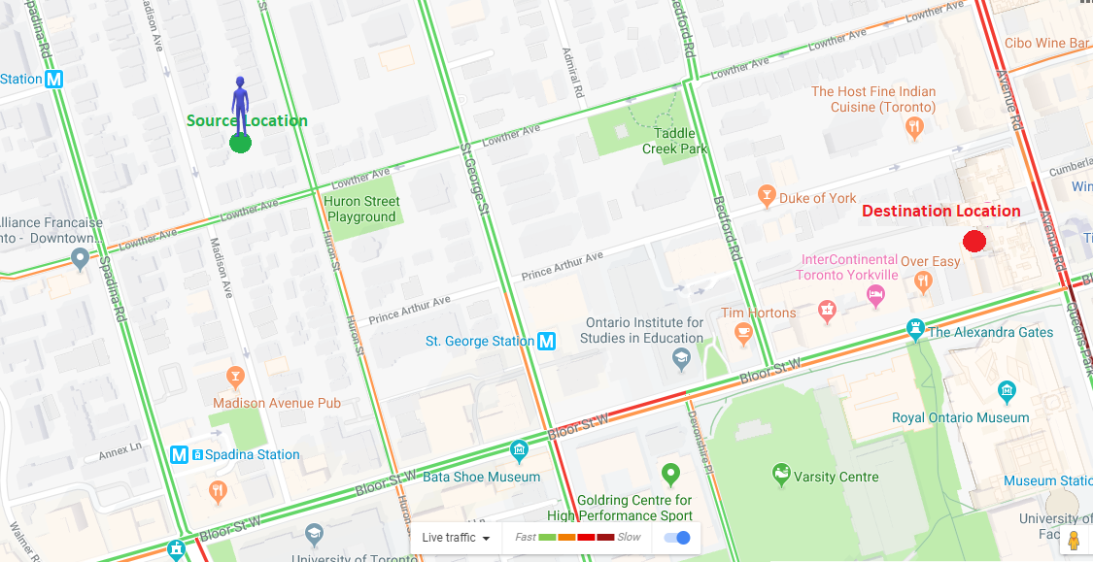
Problem Definition
The goal of the project is to find the path to go from source to destination with the least time.

Slide 4
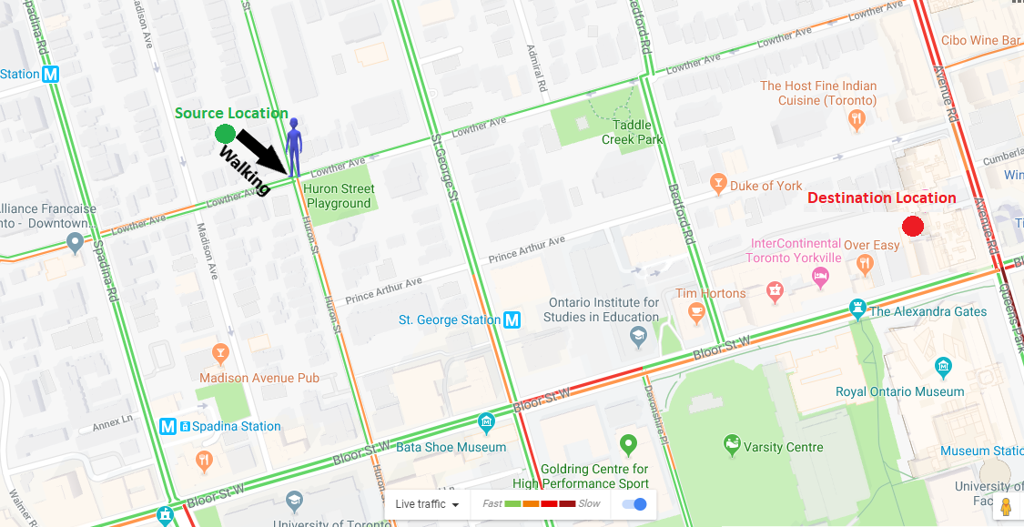
Problem Definition
The goal of the project is to find the path to go from source to destination with the least time.

Slide 5
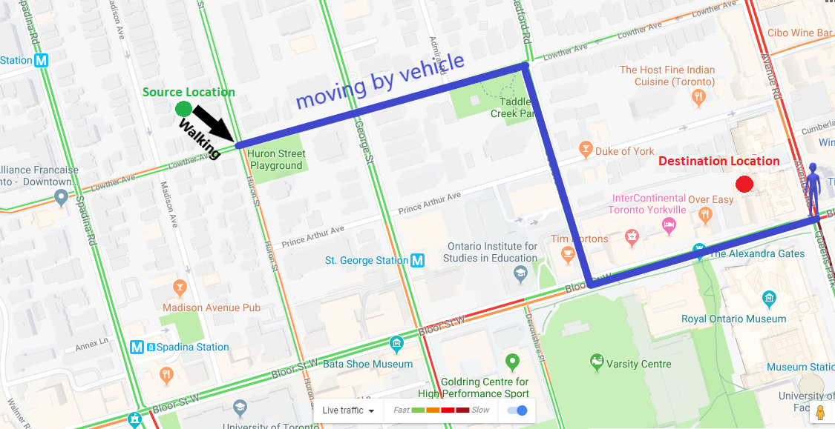
Problem Definition
The goal of the project is to find the path to go from source to destination with the least time.

Slide 6
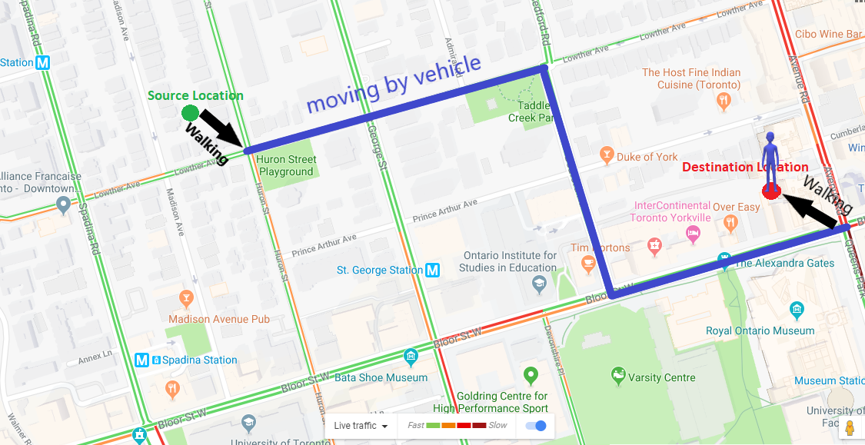
Problem Definition
The goal of the project is to find the path to go from source to destination with the least time.

Slide 7
Problem Definition
Maps: graphs whose
vertices are points in the plane and are connected by edges. Think of the vertices as intersections and the edges as roads that connect intersections.
Each road has length and speed. Vehicles on the road can not exceed its speed.

Slide 8
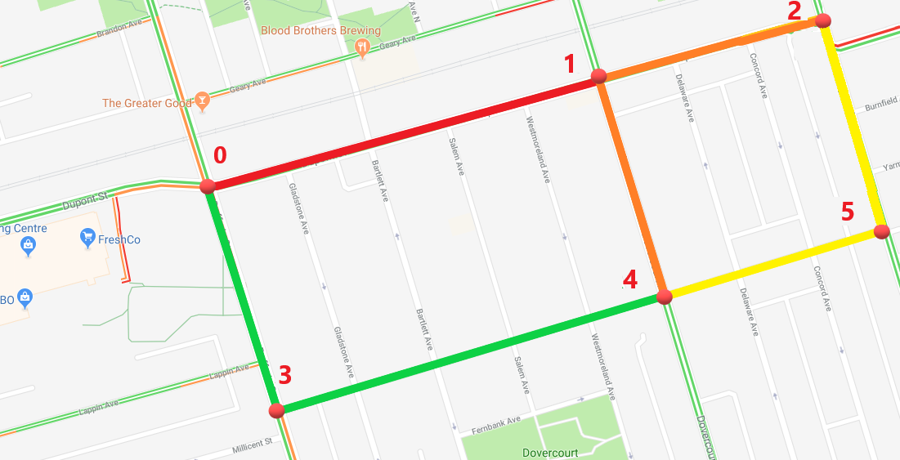
Problem Definition
In this example:
Intersection 0 is connected to intersection 3 (with road length = 0.28 km and speed = 80 km/h)
intersection 0 is connected to intersection 1 (with road length = 0.5 km and speed = 20 km/h)

Slide 9

Problem Definition
The source location is not necessarily on an intersection. The person in source can walk to any nearby intersection with speed (5 km/h).
The destination location is not necessarily on an intersection. The person can walk from any node to the destination with speed (5 km/h).

Slide 10
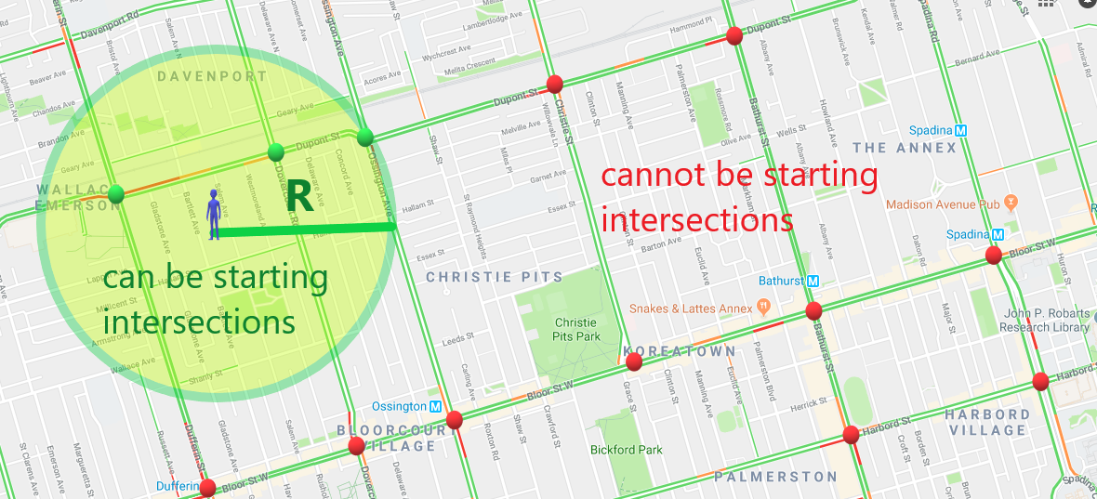

Problem Definition
The person can walk for maximum R meters to get to a starting intersection. They can also walk for maximum R meters to get from an intersection to the destination.

Slide 11
Input
Map file containing
the number of intersections and roads
list of intersections (index followed by its x and y coordinates),
list of edges (pairs of intersections, length, speed).
Queries File contains
# required queries.
x and y coordinates of Source & destination for each queries, and the maximum walking distance R.

Slide 12

Output
Your program should print (in a file)
The nodes of the path that has the shortest time.
Shortest time to get from source to destination.
The total length of the found path (vehicle moved distance + walked distance).
The total moving distance.
The total vehicle distance.
Total execution time of routing requests.

Slide 13
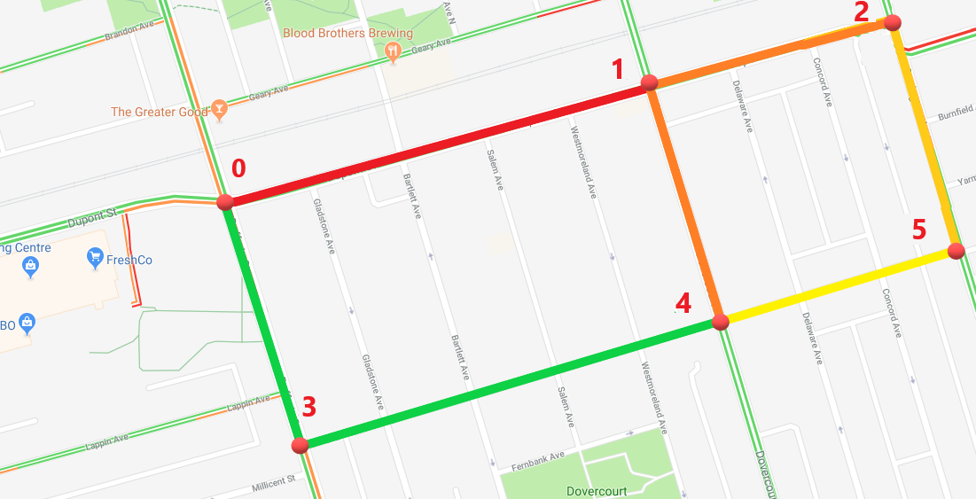
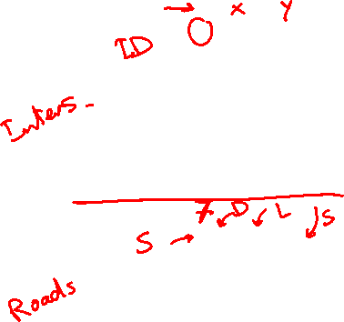
Example
Map File containing 6 vertices and 7 edges…
6
0 0.25 0.33
1 0.73 0.47
2 1.00 0.54
3 0.34 0.60
4 0.81 0.20
5 1.07 0.28
7
0 1 0.50 20
0 3 0.28 80
3 4 0.62 80
1 4 0.28 40
1 2 0.28 40
4 5 0.27 60
2 5 0.27 60

Slide 14
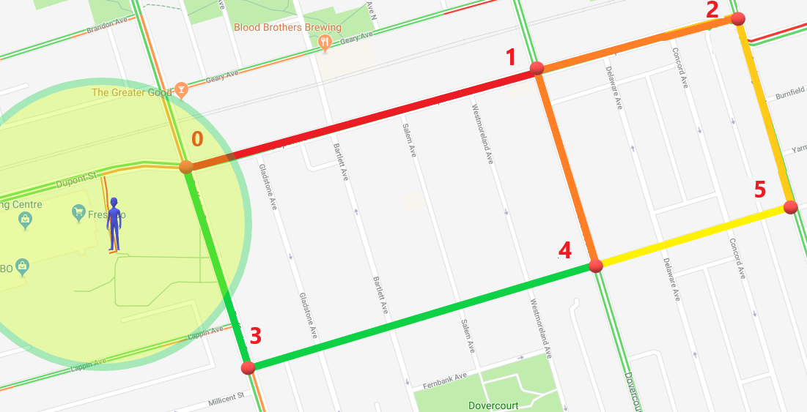

Example
Queries file containing 1 query
1
0.16 0.21 1.09 0.44 300

Slide 15
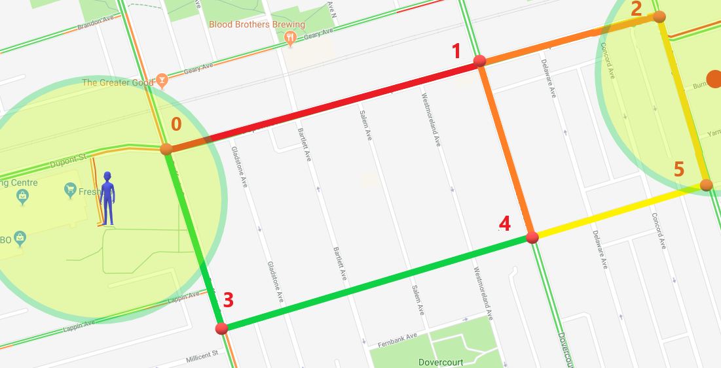
Example
Intersection 0 is the only possible starting intersection. Intersections 2 and 5 can be finishing intersections

Slide 16
Example

Slide 17
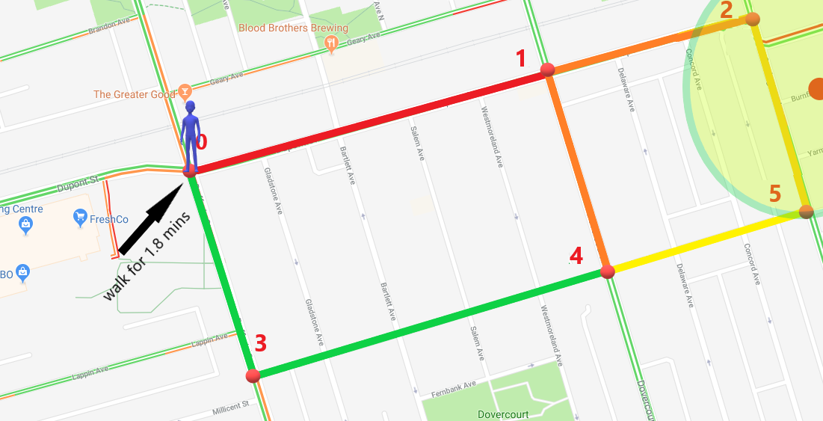

Example

Slide 18
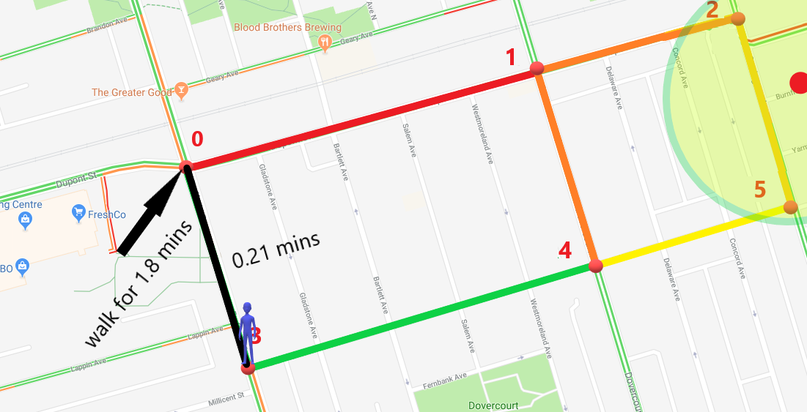
Example

Slide 19
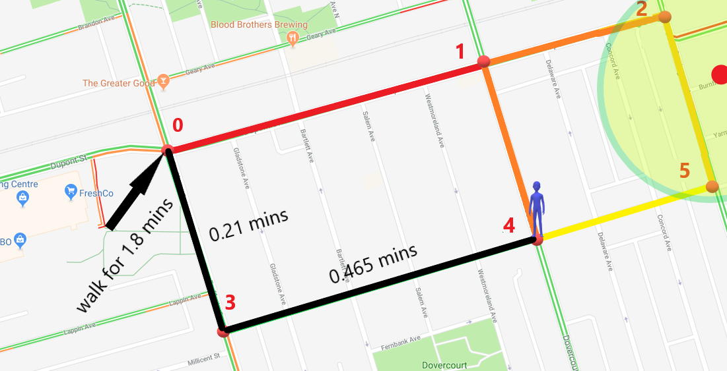
Example

Slide 20
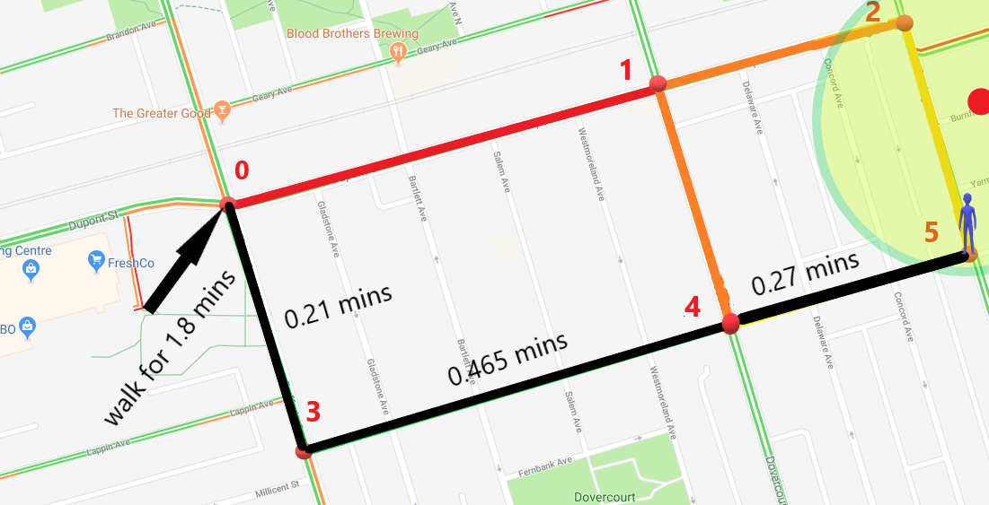
Example

Slide 21
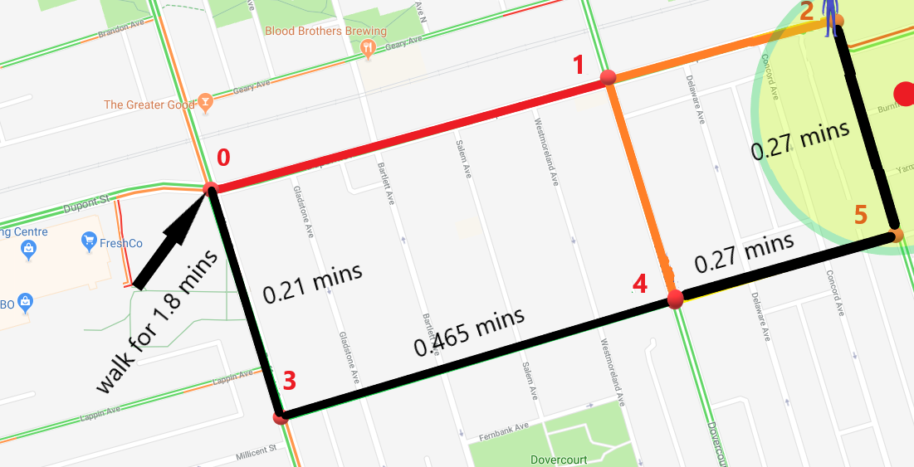
Example

Slide 22
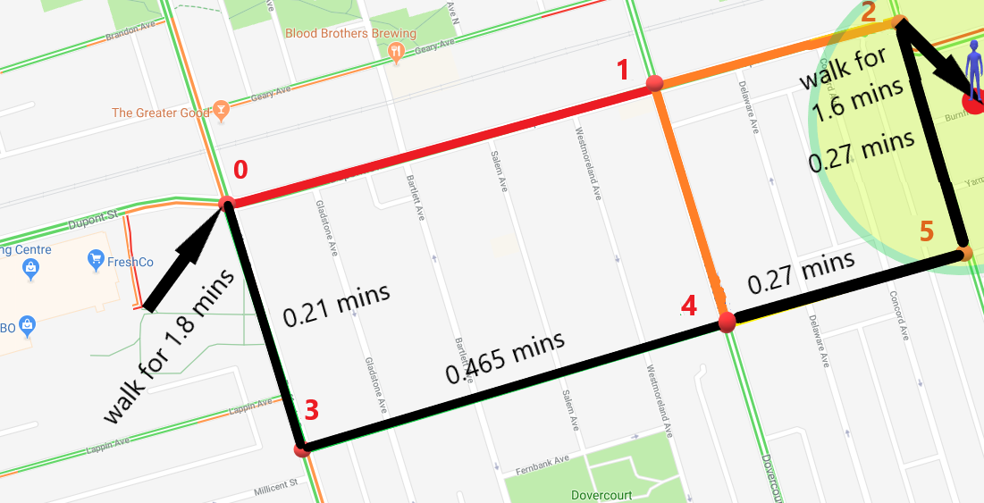
Example

Slide 23
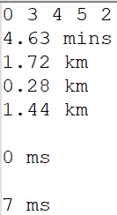

Example
OUTPUT file containing
The path nodes : 0, 3, 4, 5, 2.
Shortest time = 4.63 mins
Path length = 1.72 km
Total walking distance = 0.28 km
Total roads length = 1.44 km
Total execution time without I/O = … ms
Total execution time with I/O = … ms

Slide 24
Test Cases
1. Sample Cases
The number of intersections will not exceed 20 intersections.
The number of roads will not exceed 50 roads.
The number of queries will not exceed 10 queries.
2. Medium Cases
The number of intersections will not exceed 20000 intersections.
The number of roads will not exceed 25000 roads.
The number of queries will not exceed 1000 queries.
3. Large Cases
The number of intersections will not exceed 200000 intersections.
The number of roads will not exceed 250000 roads.
The number of queries will not exceed 1000 queries.
Refer to the attached document for more details about each case

Slide 25

Deliverables
Implementation (60%)
Graph construction.
Efficient search for the best path (with the shortest time).
Best path building.
Document (40%)
Description and code of graph construction.
Code of the shortest path algorithm.
Detailed analysis of the above codes.
Allowed Codes
Data structures code (either C# built-in data structures or other open-source data structures, other than the graph). You MUST understand and analyze it!

Slide 26
Deliverables
Important Delivery Notes

Slide 27
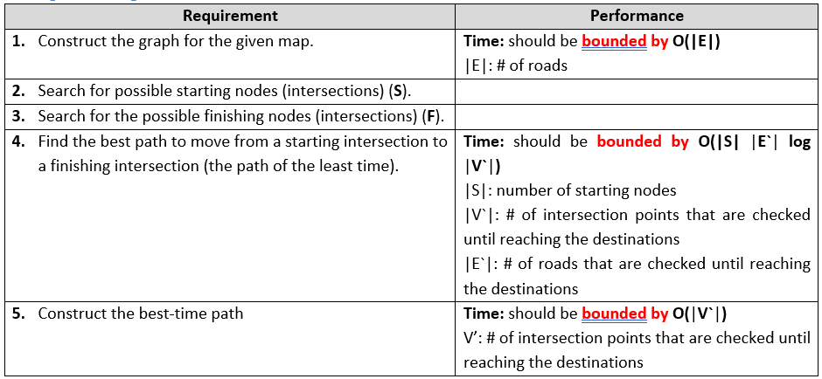
Deliverables

Slide 28
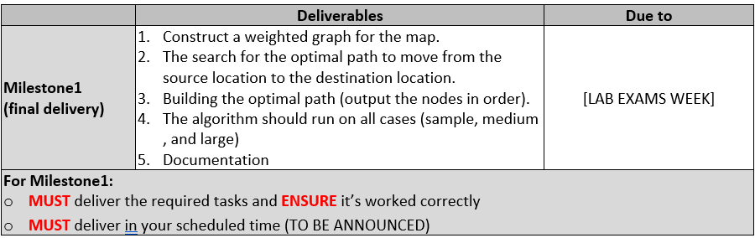
Milestones

Slide 29
Bonuses
1. Changing-speed handling:
In the case the speed is given in intervals. You have to consider the speed change in the fastest path calculation.
Refer to the attached document for more details about this bonus
2. Map Visualization:
Visualizing the map data and the shortest path.
3. Faster implementation:
for the shortest path to be less than the given bounded complexity above, (less than O(S E` log V`)).

Slide 30
REMEMBER TO…
Refer to the main document for more details about the project.
Refer to the test-cases document for more details about each case.

Slide 31



